Slide 1
Section 2.5 Sigma Notations and Summation
i) Concept of Sigma Notation, number of terms
ii) Solving for Sums using Sigma Notations
iii) Problems involving Sigma Notations
iv) Sums of Sequences involving consecutive squares, cubes, and powers
© Copyright all rights reserved to Homework depot: www.BCMath.ca

Slide 2
I) What is a Sigma Notation:
A notation that represents a series (sum)
The value of “k”
in the last term
Function
Variable in the
function
The value of “k”
in the first term
Note: The number of terms will be (b – a + 1)
© Copyright all rights reserved to Homework depot: www.BCMath.ca

Slide 3
Ex: Expand and Evaluate the following Series:
© Copyright all rights reserved to Homework depot: www.BCMath.ca

Slide 4
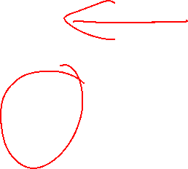

When a sigma notation contain too many terms, use the formulas from the Geometric series to find the sum
© Copyright all rights reserved to Homework depot: www.BCMath.ca

Slide 5
Ex: Evaluate the following Series:
© Copyright all rights reserved to Homework depot: www.BCMath.ca

Slide 6
Practice: Evaluate each of the following infinite Geometric series:
Since:
the infinite geometric series will
become infinity
© Copyright all rights reserved to Homework depot: www.BCMath.ca

Slide 7
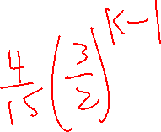


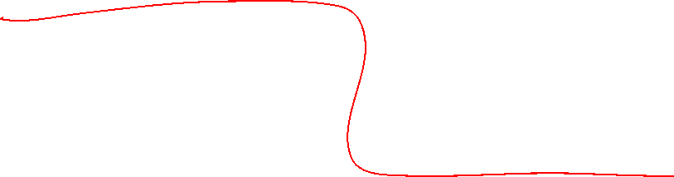

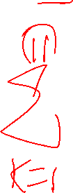


EX: Given the following Geometric Series, rewrite as a sigma Notation:

Slide 8
Challenge: Evaluate:
© Copyright all rights reserved to Homework depot: www.BCMath.ca

Slide 9
Homework:
Assignment 2.5

Slide 10
Difficult Sigma Notation Question:
Compute the following and provide your answer in the form of “a/b”

Slide 11
Use partial fractions to split the fraction into two parts:

Slide 12
Now we can rearrange the fraction in the sigma notation:

Slide 13
Now list out the first few terms to find a pattern:
Everything cancels out
except the first two fractions

Slide 14
So therefore:

